Slide 1
MTCNN

Slide 2
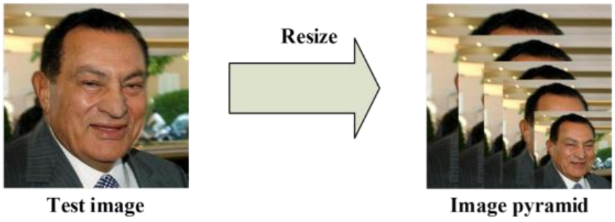
Stage 1: P-NET
Fig: Image Pyramid

Slide 3
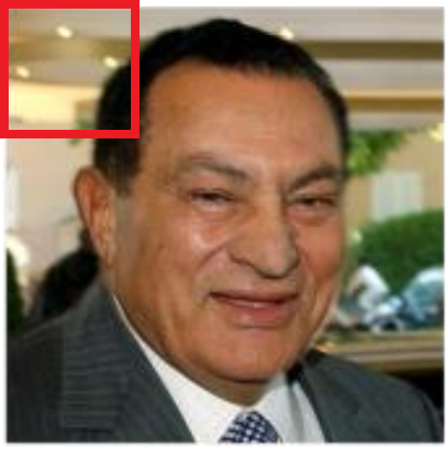
Stage 1: P-NET (Cont.)
For each scaled copy 12x12 stage kernel 1 will go through every part of the image.
It starts from the top left corner (0,0) to bottom right corner (12,12).
(0,0)
(12,12)

Slide 4
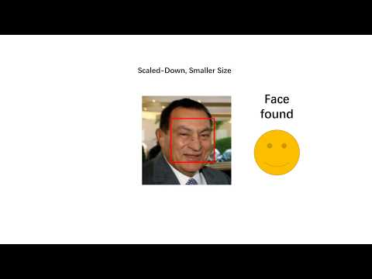
Stage 1: P-NET (Cont.)

Slide 5
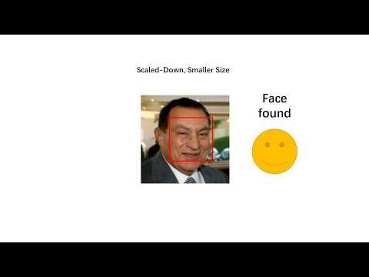
Stage 1: P-NET (Cont.)
If the kernel notice a face then it send the co-ordinate.
Repeat the Process (0+2a, 0+2b) to (12+2a, 12+2b) shifting the 12x12 kernel 2Px.

Slide 6
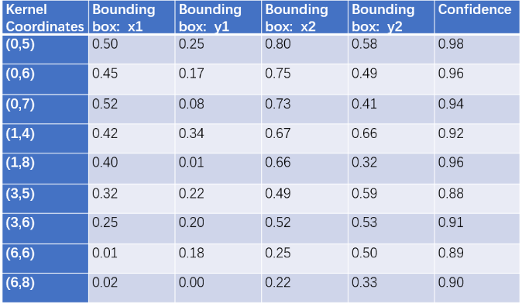
Stage 1: P-NET (Cont.)
After passing in the image, we need to create multiple scaled copies of the image and pass it into the first neural net — P-Net — and gather its output.

Slide 7
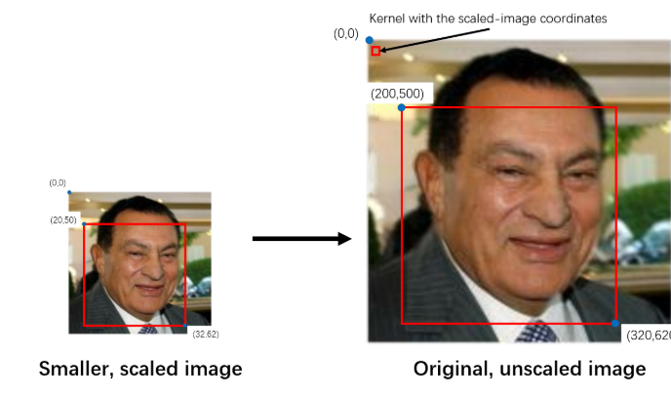
Stage 1: P-NET (Cont.)
We need to parse the P-Net output to get a list of confidence levels for each bounding box, and delete the boxes with lower confidence

Slide 8
Stage 1: P-NET (Cont.)
After we’ve picked out the boxes with higher confidence, we will have to standardize the coordinate system, converting all the coordinate systems to that of the actual, “un-scaled” image. Since most kernels are in a scaled-down image, their coordinates will be based on the smaller image.

Slide 9
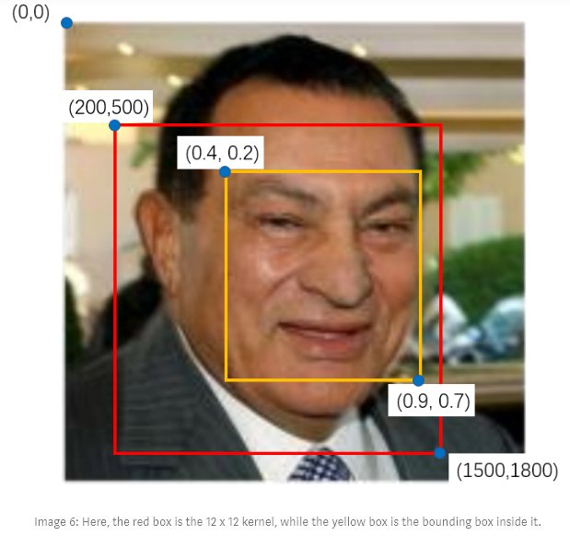
Afterward, we convert the bounding box coordinates to coordinates of the actual image.
In this image, the red box represents the 24 x 24 kernel, resized back to the original image
We can calculate the width and height of the kernel: 1500–200 = 300, 1800–500 = 300.That is because we’re using the coordinates of the kernel in the original image
Afterwards, we multiply the bounding box coordinates by 300: 0.4x300 = 120, 0.2x300 = 60, 0.9x300 = 270, 0.7x300 = 210.
Finally, we add the top left coordinate of the kernel to get the coordinates of the bounding box: (200+120, 500+60) and (200+270, 500+210) or (320,560) and (470,710).

